Slide 1
The Pursuit of Hoppiness
Presented by: Hannah Kosinovsky, John Yan, David Nguyen

Slide 2
Introduction
Hello…

Slide 3
1. How many breweries are present in each state?

Slide 5
2. Merge beer data with the breweries data. Print the first 6 observations and the last six observations to check the merged file.

Slide 6
Brewery ID | Beer Name | Beer ID | ABV | IBU | Style | Ounces | Brewery Name | City | State
1 | Get Together | 2692 | 0.045 | 50 | American IPA | 16 | NorthGate Brewing | Minneapolis | MN
1 | Maggie’ Leap | 2691 | 0.049 | 26 | Milk / Sweet Stout | 16 | NorthGate Brewing | Minneapolis | MN
1 | Wall’s End | 2690 | 0.048 | 19 | English Brown Ale | 16 | NorthGate Brewing | Minneapolis | MN
1 | Pumpion | 2689 | 0.060 | 38 | Pumpkin Ale | 16 | NorthGate Brewing | Minneapolis | MN
1 | Stronghold | 2688 | 0.060 | 25 | American Porter | 16 | NorthGate Brewing | Minneapolis | MN
1 | Parapet ESB | 2687 | 0.056 | 47 | Extra Special / Strong Bitter (ESB) | 16 | NorthGate Brewing | Minneapolis | MN

Slide 7
Brewery ID | Beer Name | Beer ID | ABV | IBU | Style | Ounces | Brewery Name | City | State
556 | Pilsner Ukiah | 98 | 0.055 | NA | German Pilsener | 12 | Ukiah Brewing Company | Ukiah | CA
557 | Heinnieweisse Weissebier | 52 | 0.049 | NA | Hefeweizen | 12 | Butternuts Beer and Ale | Garrattsville | NY
557 | Snapperhead IPA | 51 | 0.068 | NA | American IPA | 12 | Butternuts Beer and Ale | Garrattsville | NY
557 | Moo Thunder Stout | 50 | 0.049 | NA | Milk / Sweet Stout | 12 | Butternuts Beer and Ale | Garrattsville | NY
557 | Porkslap Pale Ale | 49 | 0.043 | NA | American Pale Ale (APA) | 12 | Butternuts Beer and Ale | Garrattsville | NY
558 | Urban Wilderness Pale Ale | 30 | 0.049 | NA | English Pale Ale | 12 | Sleeping Lady Brewing Company | Anchorage | AK

Slide 8
3. Report the number of NA's in each column.

Slide 9
Brewery ID | Beer Name | Beer ID | ABV | IBU | Style | Ounces | Brewery Name | City | State
0 | 0 | 0 | 62 | 1005 | 0 | 0 |  | 0 | 0

Slide 10
4. Compute the median alcohol content and international bitterness unit for each state. Plot a bar chart to compare.

Slide 11
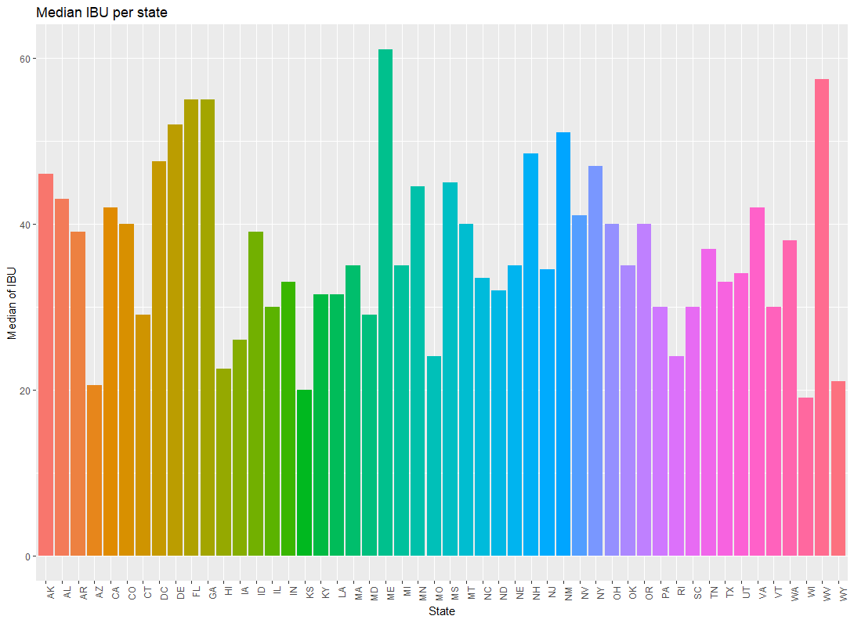

Slide 12
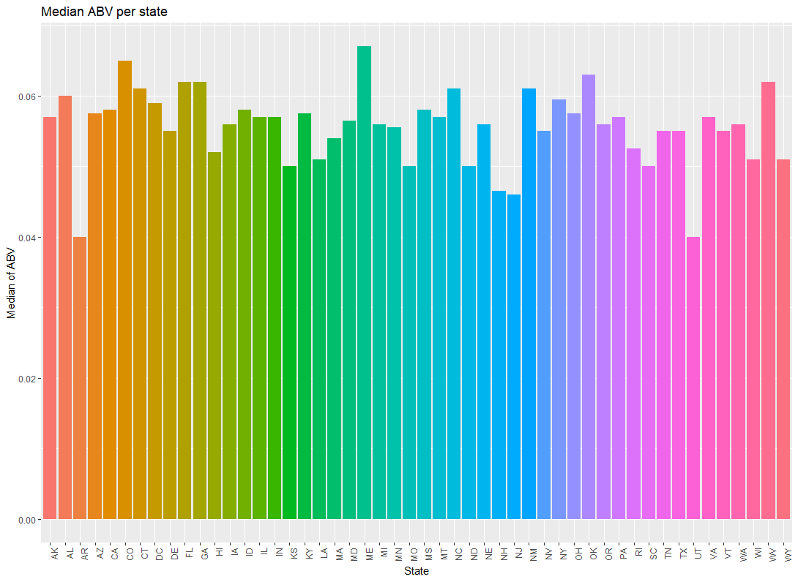

Slide 13
5. Which state has the maximum alcoholic (ABV) beer? Which state has the most bitter (IBU) beer?

Slide 14
Colorado has the maximum alcoholic (ABV) beer at 0.128 for Lee Hill Series Vol. 5 – Belgian Style Quadrupel Ale.

Slide 15
Oregon has the most bitter (IBU) beer at 138 for 3745 Bitter Bitch Imperial IPA.

Slide 16
6. Summary statistics for the ABV variable.

Slide 17
Mean | Max | Min | Median | Std
0.05991388 | 0.125 | 0.027 | 0.057 | 0.01357633

Slide 18
7. Is there an apparent relationship between the bitterness of the beer and its alcoholic content? Draw a scatter plot.

Slide 19
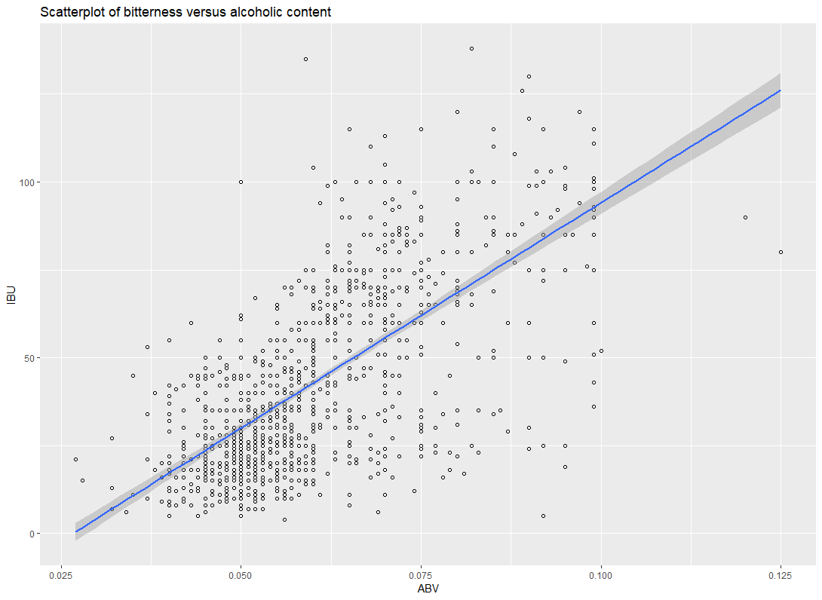
The correlation coefficient is 0.67 and that indicates a positive moderate relationship between the two variables.

Slide 20
Conclusion
In conclusion…

